Slide 1
NBA Player Rating & MVP Prediction
Yuchen He, Lei Liu

Slide 2
Index
Background and Facts
Goals of the project
Use cases
Methodology
Data sources
Milestones
Program in Scala code repository
Acceptance criteria

Slide 3
Background and Facts
The National Basketball Association Most Valuable Player Award (MVP) is an annual National Basketball Association (NBA) award given to the best performing player of the regular season.
There have been 61 MVPs in the NBA with the first being Bob Pettit in the 1956-57 season.
Since 1980, the selection of the MVP has been determined by sportswriters and broadcasters.

Slide 4
Goals of the project
Scoring NBA Players according to the performance
Predicting the winner of the Most Valuable Player (MVP) for 2018-19 regular season. Using both NBA players individual statistics and MVP voting history from 2000-01 to 2017-18 season.

Slide 5
Use Cases
User inputs stats of one player and get his rating.
User inputs stats of all players in new season and get predicted top 10 MVP runners and the final winner.

Slide 6
Methodology
Import and clean the data
Prepare data for training and evaluation
Create the model
Fit training data to the model
Evaluate the model
Make the prediction and get players’ ratings.
Store a pipeline and the model

Slide 7
Data Source
Kaggle: https://www.kaggle.com/drgilermo/nba-players-stats
(NBA Players’ stats since 1950)
Basketball Reference: https://www.basketball-reference.com/leagues/NBA_2018.html
(NBA Players’ stats in new season)
2k Ratings: www.2kratings.com
(Players’ ratings)

Slide 8
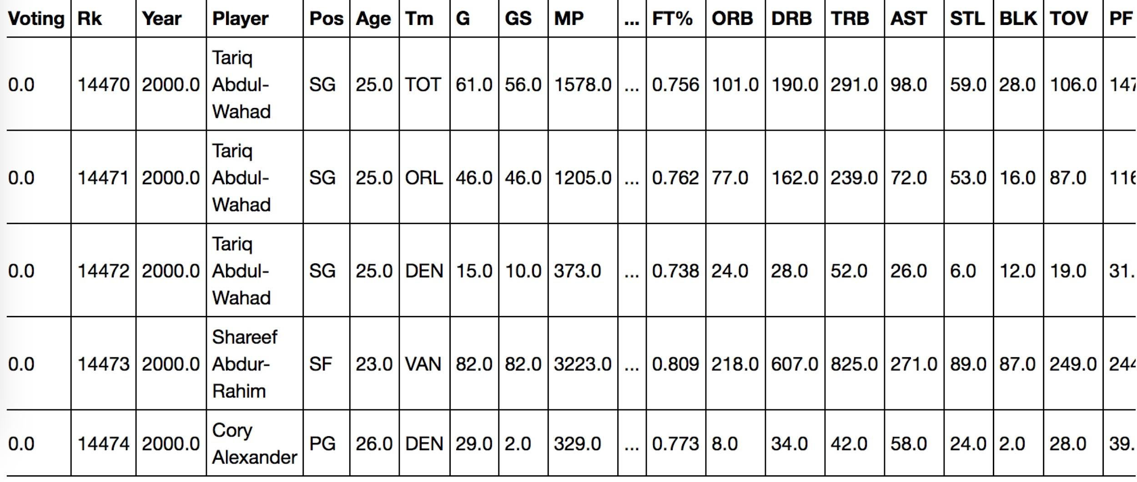
Data Source
The training and testing dataset contains 10885 minutes of data ranging from 2000 to 2018 NBA seasons and predicting dataset contains 433 minutes of data of 2018-2019 NBA season.

Slide 9
Milestones
By November 23th | By November 30th | By December 7th
Call the spark and prepare pipelines for the model Prepare dataset. | Create predicting and rating model and fit training data to the model | Evaluate and optimize the model and make the final prediction and ratings.

Slide 10
Program in Scala
Stats.scala: Load the dataset and prepare the data for training and testing
Players.scala: Create player class
PipelineConstruction.scala: Create the pipeline
BuildAndSaveModel.scala
Machine Learning Libraries:
spark.ml.regression.{RandomForestClassificationModel, RandomForestClassifier}
spark.ml.regression.LinearRegression

Slide 11
Acceptance Criteria
Get 80% accuracy in Top 10 MVP candidates.
Target MSE of final MVP prediction is lower than 0.05.
The difference between the predicted score and the actual score is less than 2.

